Slide 1
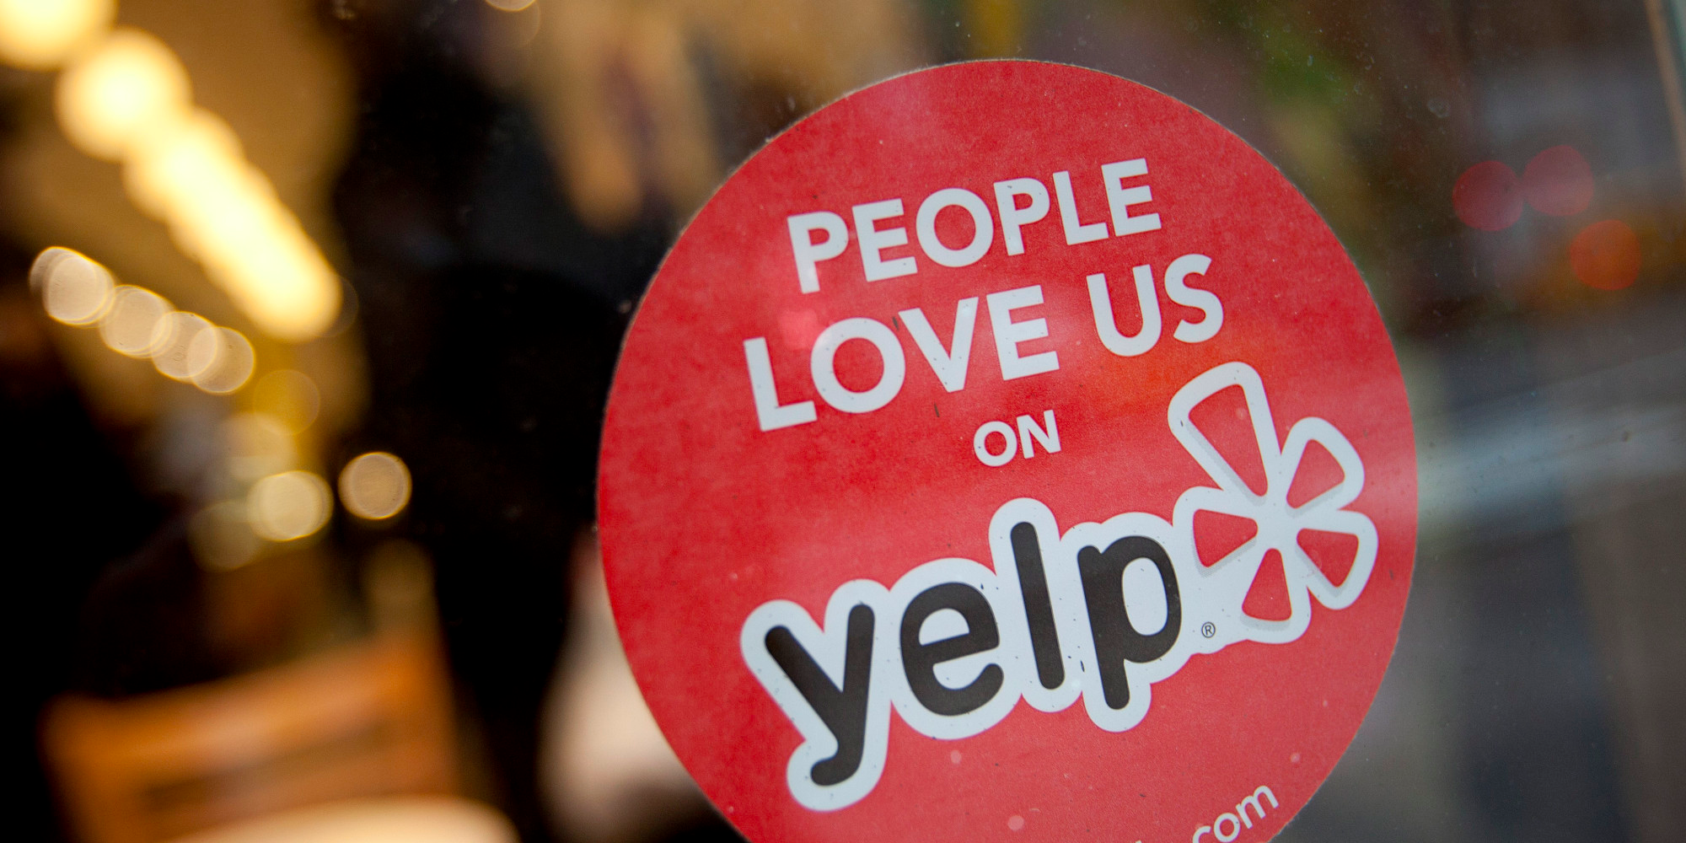
Identifying Yelp Trendsetters

Slide 2
Why try to identify trendsetters?
Trendsetters are valuable new content creators
By identifying them, Yelp can increase their engagement
Give the trendsetters a badge
Give vouchers to try out new businesses
Gain insight on how Yelp can create more trendsetters in the future

Slide 3
What’s in the data?
5 separate datasets:
Business (60K+)
Reviews (1M+)
User (366K+)
Tip
Check-in

Slide 4
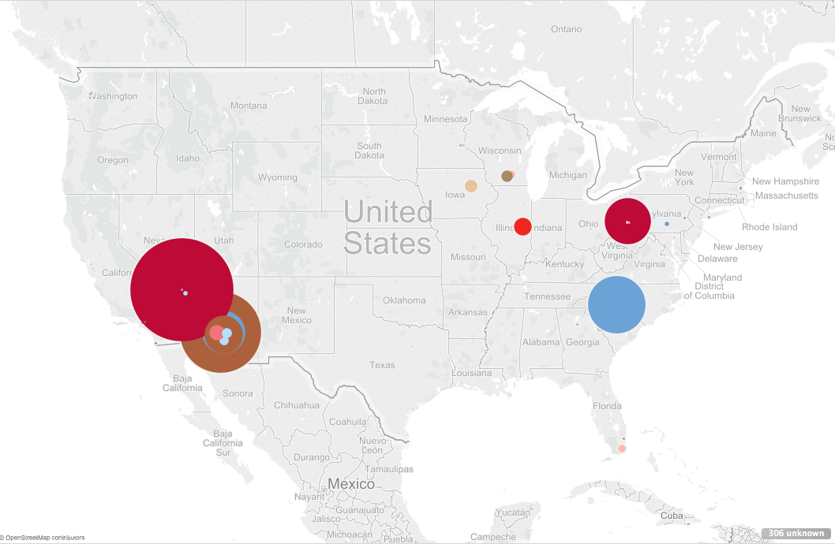
https://public.tableau.com/profile/karissa.nanetta#!/vizhome/YelpBusinessLocations/Locations

Slide 5
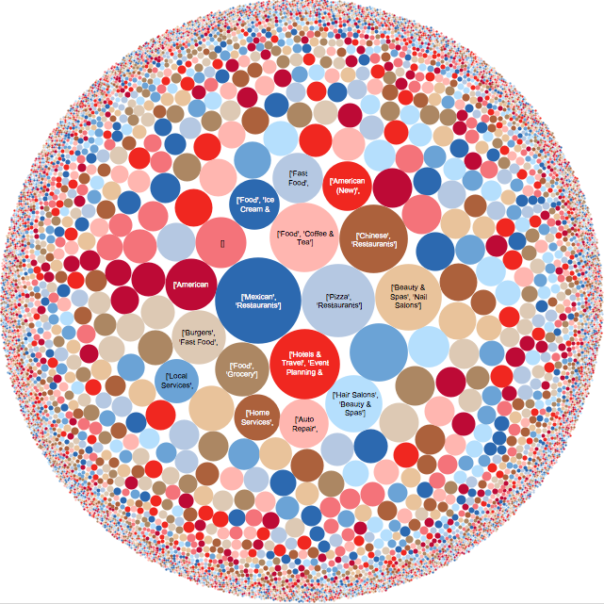
What’s in the data?
https://public.tableau.com/profile/karissa.nanetta#!/vizhome/YelpBusinessDiversity/BusinessCounts

Slide 6
Feature engineering
SPEED: How soon does a Yelp user leave a review?
How many days since the first Yelp review?
How many reviews are there already when a user leaves a review?
POPULARITY: How well is the business doing?
How many reviews are there to date?
What is the business’ rating?
Network: How many people are listening to the trendsetters?
Fans, friends, compliments, votes (already in original data)

Slide 7
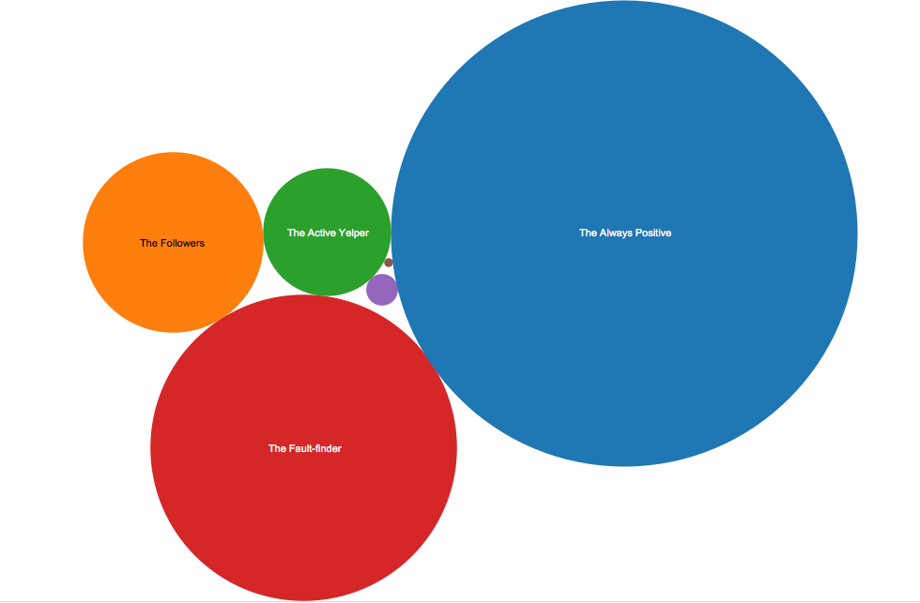
K-means Clustering to the rescue!
https://public.tableau.com/profile/karissa.nanetta#!/vizhome/YelpClusters/YelpSegmentdetails

Slide 8
The Process
One notebook to load data, link datasets, and perform feature engineering (75% of time)
One notebook to run unsupervised learning (10% of time)
Tableau to perform data viz (15% of time)

Slide 9
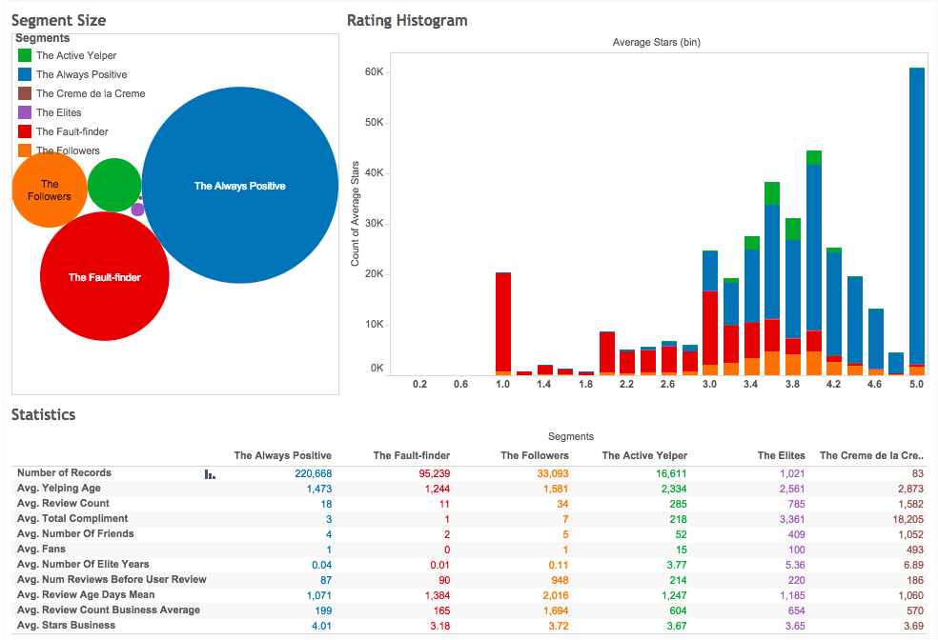
The clusters
https://public.tableau.com/profile/karissa.nanetta#!/vizhome/YelpClusters/YelpSegmentdetails

Slide 10
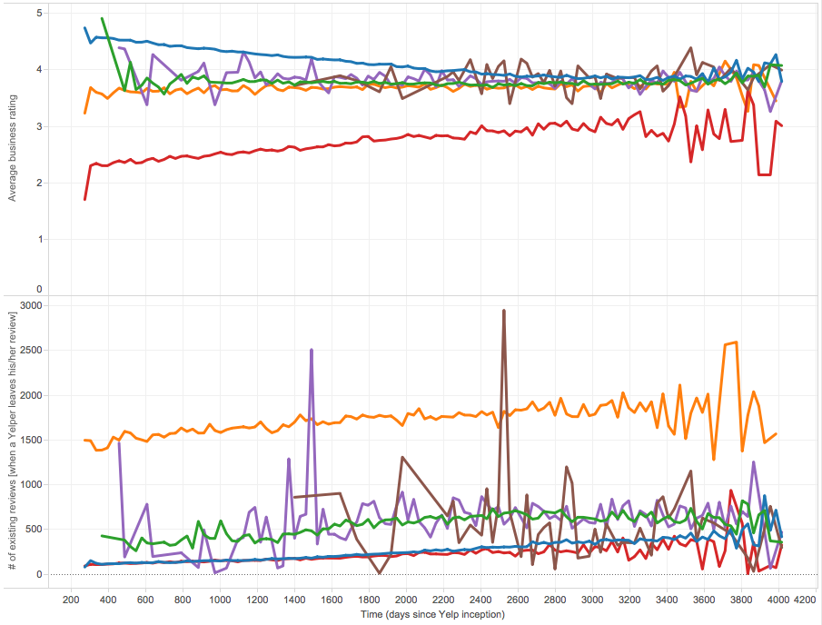
Youngest Yelpers
Oldest Yelpers
https://public.tableau.com/shared/KNX9W3Y3S?:display_count=yes
https://public.tableau.com/profile/karissa.nanetta#!/vizhome/YelpClusters/YelpSegmentdetails

Slide 11
What do the clusters tell us?
The “Crème de la Crème” are the trendsetters
Early reviewers, large following, and popular businesses
The “Always Positive” might be friends & family of the businesses… OR BOTS!
Very early reviewers, always good reviews, not-so-popular businesses
A large group in Yelp are “Fault-Finders” – the opposite of trendsetters
Very early reviewers, only signs up for Yelp to give negative reviews
I fall under “The Followers”
Only tries out businesses with 4+ stars with hundreds of reviews

Slide 12
Future Improvements
Explore supervised learning
Analyze effects on types of businesses (e.g. restaurants, laundromats, doctors, etc.)
Given more data…
Perform longitudinal analysis
Analyze user profile texts to detect bots

Slide 13
Questions? Feedback? Any other features I should use?

